Slide 1
Screening tests
DID
Radioimmunoassay
Enzyme-linked immunosorbent assay ELISA

Slide 2
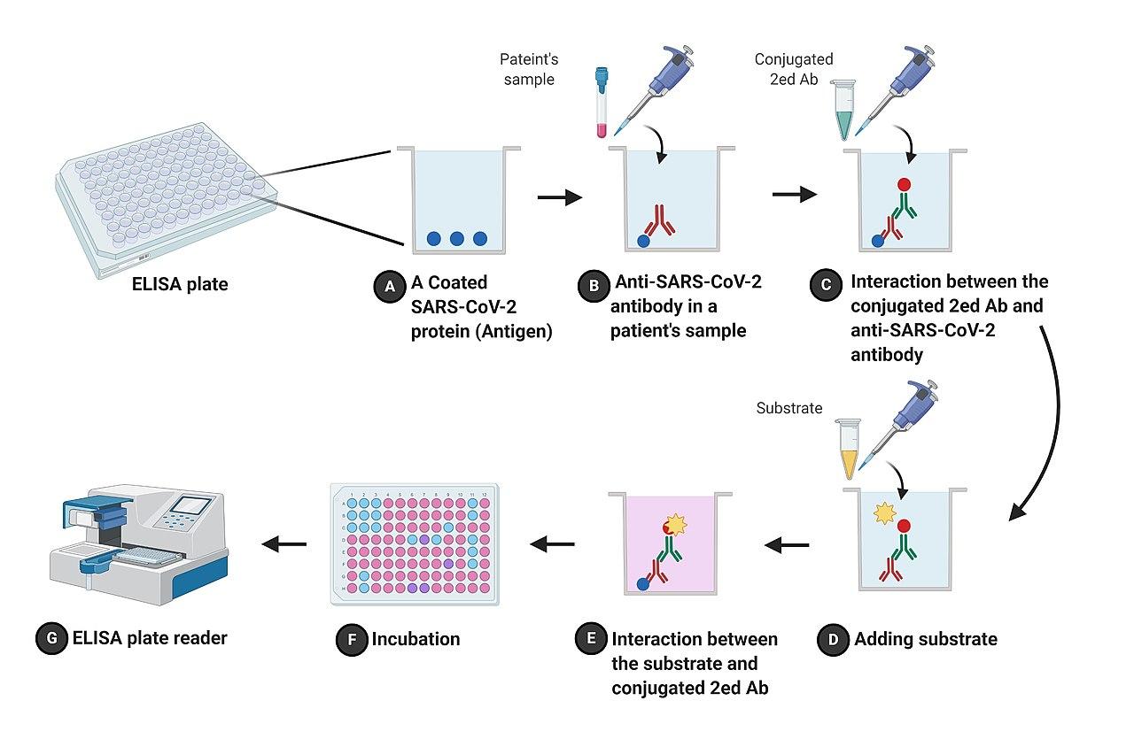

Principle
-Enzyme
wash
wash
Optical density
Colored substrate

Slide 3
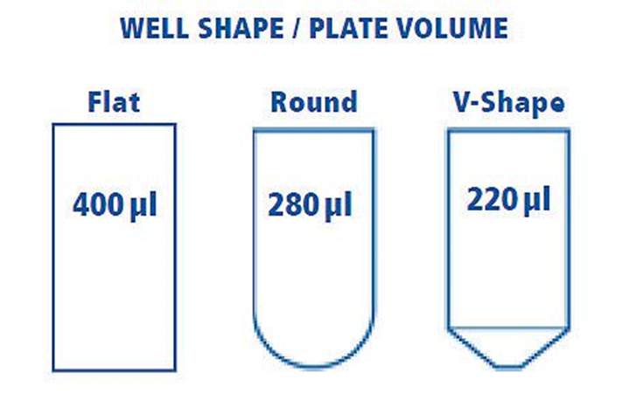
Microtiter plates
a solid support (usually a polystyrene ) non-specifically bind protein antigens with high affinity (via adsorption to the surface)
Bottom Shapes Of 96-Well Plates
The 96-well format microplates are available in four distinct bottom shapes. .
U-bottom; round-shaped well bottom, used in agglutination assay
V-bottom; conically-shaped well bottom, used in precipitation reactions
F-Bottom; flat well-bottom, used in ELISA and tissue culture
Surfaces
sterile and non-sterile.

Slide 4
ELISA
Ag coating:
soluble proteins: 1-10 ug/ml optimal
A. Too little reduce the sensitivity
Too much wasteful and produce multilayers so that binding is unstable
B. The Buffer: Carbonate (the best) or Tris or Phosphate without detergent
C. Normal incubation: overnight at 4⁰C, sealed, can be kept for several weeks
Cells:
Attached to plastic surfaces via bridging molecules e.g Glutaraldehyde or PHA

Slide 5
Blocking solution: is a solution of irrelevant protein, mixture of proteins, or other compound that passively adsorbs to all remaining binding surfaces of the plate to prevent any nonspecific binding
Incubation with BSA, gelatin or OVA
Block the remaining binding sites
Washing
Addition of detergent to the buffer: Tween 20 ( 0.05%)
Removal of nonspecific binding
Inefficient washing: common cause of nonspecific variability
Usually 3x

Slide 6
Tested mice serum
Normally tested mouse serum without dilution
Enzyme Ab Conjugate (second Ab):
The preferred E: horseradish peroxidase (HRP) and its Substrate o-phenelene diamine (OPD) produce orange color (mutagenic)
HRP inactivated above 15⁰C
Not advisable when using plant tissues due to endogenous HRP
Alkaline phosphatase AP is a good alternative with PNPP as substrate (avoid phosphate buffer)

Slide 7
Controls: to have reliable results
To test for undesired Ab binding
Coat alternative Ag
2. To test for nonspecific Ab:
Add irrelevant Ab
3. To quantify specific binding
Add known positive Ab
4. To test for nonspecific conjugate label
Add buffer

Slide 8
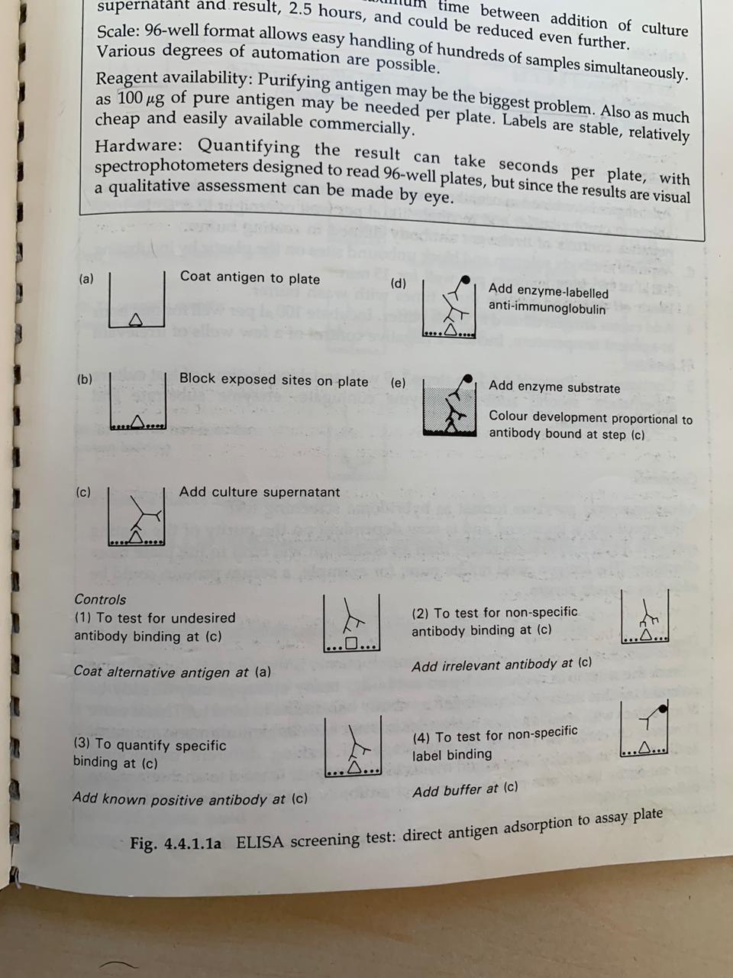
Controls

Slide 9
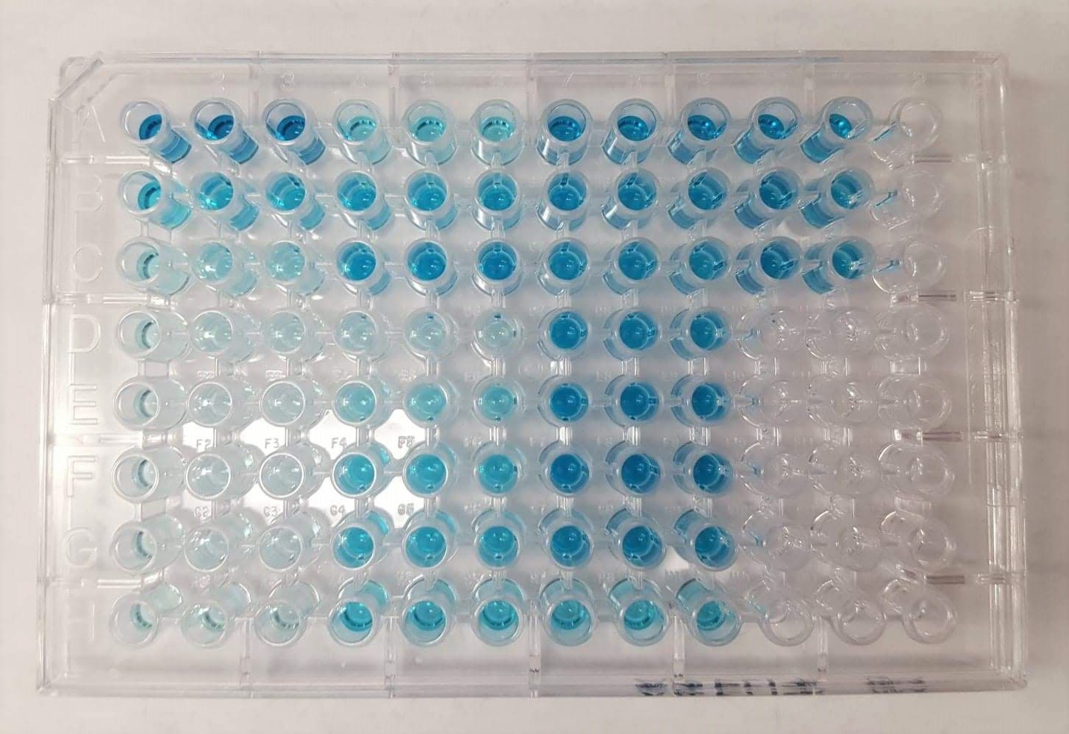

Slide 10
Procedure
https://www.youtube.com/watch?v=zR_xlV5v_f4

